Slide 1
Public Relations and the Emerging Trends in the Workplace Post-Covid-19
Rotimi Williams Olatunji, PhD arpa, MNIPR; Professor, Public Relations & Advertising, Dean, LASU School of Communication . Paper presented at Bangalore University, Department of Communication, 20th October 2020
14TH LASU VIRTUAL LECTUR

Slide 2
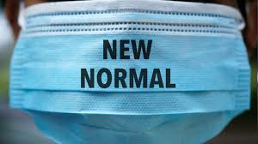
Discussion Guide
Introduction
PR & NEW NORMA
Crisis Communication
Management approaches to Post-Covid-19
PR and New Normal
Implications & Conclusion

Slide 3
COVID-19 Update
Nigeria Confirmed Cases
Global Confirmed cases 17/10/2020
Nigeria’s Total 61,194 (17/10/2020)
Recovered= 52,304
Deaths = 1,119
Global | Confirmed cases
Confirmed | 39.4 Million
Recovered | 27.1 Million
Deaths | 1.1 Million

Slide 4
Understanding Crisis
Crisis refers to “an event, revelation, allegation or set of circumstances which threatens the integrity, reputation, or survival of an individual or organisation. It challenges the public’s sense of safety, values or appropriateness. A crisis can create three related threats: (1) public safety, (2) financial loss, and (3) reputation loss. (Sapriel, C. (2003, p. 1) Journal of Communication Management Vol. 7, pp. 1-9)

Slide 5
Public Relations: What’s it about?
Public relations is the theory and practice of managing communications and relationships between a particular organization and its publics
The 1975 Foundation for PR Research & Education definition, in part:
Public Relations is a
  distinctive management function which helps establish and maintain mutual lines of communication…. Involves the management of problems and issues; … defines and emphasizes the responsibility of management to serve public interest; helps management to keep abreast of and effectively manage change; serving as an early warning system to help anticipate trends; and uses research and sound ethical communication techniques as its principal tools (Seitel, 1989)

Slide 6
PR & Crisis Management
In general, a crisis can be any occurrence which causes an unstable and dangerous situation and affects a community, a group of people or whole society. A crisis usually happens at a short notice and triggers the feeling of fear and threat which cause a sequence of unexpected events. A crisis creates situations where time is short and a quick and effective decision has to be taken. (Crisis causes elements of surprises, uncertainties & instability https://www.marketing91.com/types-of-crisis/ on 13/07/2020)
Each crisis is unique
COVID-19 pandemic has all the characteristics of a crisis. But what type of Crisis is it?

Slide 7
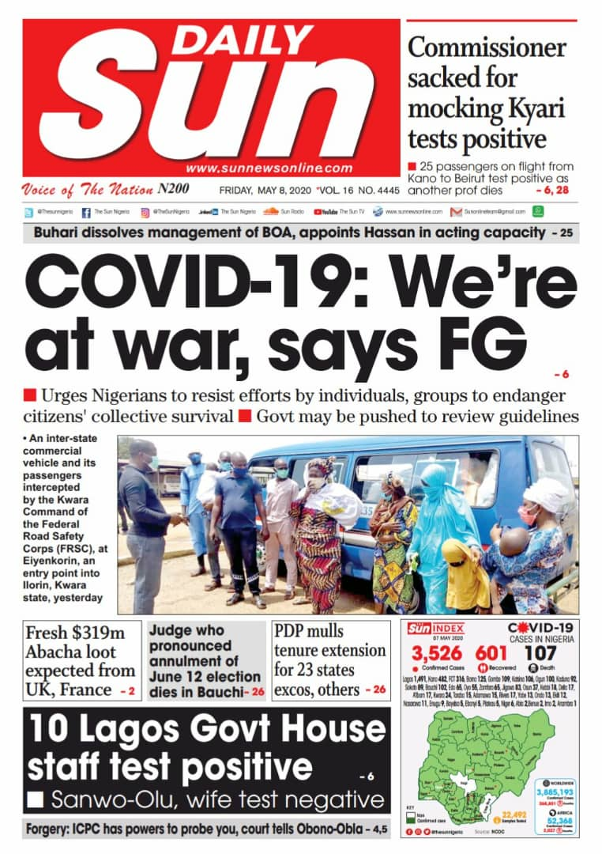

COVID-19: A Unique Crisis

Slide 8
Types of Crisis
Classification A | Classification B | Classification C
Personal/Organisational/society-wide crisis | Immediate Crisis (Happenings now) | Known/Known
Scandals and Shenanigans | Emerging crisis – can be anticipated and minimized at early stages | Known Unknowns
Man-made Crisis/ Antagonistic attacks | Sustained crisis – involves situations that may linger for years | Unknown- Knowns
Accidents/Disasters/Pandemic |  | Unknown Unknowns

Slide 9
Crisis Management Process
As a process, crisis management is not just one thing. Crisis management can be divided into three phases: (1) pre-crisis, (2) crisis response, and (3) post-crisis.
1. The pre-crisis phase is concerned with prevention and preparation.
2. The crisis response phase is when management must actually respond to a crisis.
3. The post-crisis phase looks for ways to better prepare for the next crisis and fulfils commitments made during the crisis phase including follow-up information. (New Normal Phase-NN)
(British Institute of Public Relations (2007))
https://instituteforpr.org/crisis-management-and-communications/ ON 13/07/2020

Slide 10
Pre- COVID-19 Crisis Management
Activities | Comments
Have a crisis management plan and update it at least annually. | Most African countries were unprepared for COVID-19, and so could not have elaborated Pre-crisis Management Plans. However, experiences of Ebola Crisis were helpful
Have a designate crisis management team that is properly trained. | Partially true of Lagos State and CDC, Lagos
Conduct exercise at least annually to test the crisis management plan and team. | Not sure for Lagos State and CDC, Lagos
Pre-draft select crisis management messages including content for dark web sites and templates for crisis statements. Have the legal department review and pre-approve these messages | Doubtful for Lagos State and CDC, Lagos

Slide 11
2. Crisis Response Phase
The crisis response is what management does and says after the crisis hits. Public relations plays a critical role in the crisis response by helping to develop the messages that are sent to various publics.
1 Initial crisis response-
2 Reputation repair and behavioural intentions.

Slide 12
COVID-19 Crisis Response Phase
Activities | Comments
1. Be quick and try to have initial response within the first hour.. | Experiences of Ebola Crisis were helpful
2. Be accurate by carefully checking all facts. | Average performance
3. Be consistent by keeping spokespeople informed of crisis events and key message points. | Average performance
4. Make public safety the number one priority. | Average performance
5. Use all of the available communication channels including the Internet, Intranet, and mass notification systems. | Average performance
6. Provide some expression of concern/sympathy for victims | Average performance
7. Be ready to provide stress and trauma counselling to victims of the crisis and their families | Big issue

Slide 13
2b. Reputation repair and behavioural intentions
Activities | Comments
1. Attack the accuser | Not Applicable
2. Denial | Averagely so
3. Scapegoat | Averagely so
4. Give Excuses | Averagely so
Ingratiation- Praising stakeholders for their action | Averagely so- Frontline officers
6. Provide justification | Averagely so
7. Reminder | Very much so
Compensation | Poorly handled
Apology | Not applicable

Slide 14
5-Common Failures in Health Crisis Communication
Reynolds B. (n.d.) Crisis & Emergency Risk Communication (What the Public needs when risks are uncertain. Atlanta, GA. Zika Action Plan. Accesses: www.cdc.org on 13/07/2020
Mixed messages from multiple experts.
Information released late.
Paternalistic attitudes.
Not countering rumors and myths in real-time.
Public power struggles and confusion.

Slide 15
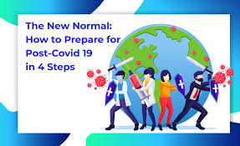
Crisis Communication Principles
Be the first to break
Be Right
Be Accurate
Be Credible
Be Empathic
Promote action
Respect people’s sensibilities

Slide 16
Spillovers in the New Normal (NN)
Change in value systems
Change in supply chain and knowledge economy
Changes in health & Safety considerations
Changes in hospitality & Transport industries
Changes in retail industry
“Due to social distancing, lockdown and continuous mitigation measures, people would surely be starting to change their habits, and some habits will stick. The new normal comes to ensure the community and organizations’ rapid response, and efficient adaptation to change. This would ensure that the world would be more ready for the re-emergence with a stronger position after each shock or crisis or global challenge”
-Buheji, M. & Ahmed, D. (2020, p. 167)

Slide 17
Post-Covid-19 NN
The next normal (new normal) after COVID-19 would be unlike any previous experience in our lifetime. The post-Covid 19 won’t be similar to the pre-Covid years. The pandemic would touch the main issues of life, what we believe in, how we visualize our role in life, our next generation essentials, how we would react to a coming life crisis. Everything would be pound to change
Buheji, M. & Ahmed, D. (2020, p. 167). “Planning for ‘The New Normal’: Foresight and management of the possibilities of socio-economic spillovers due to COVID-19 pandemic”, Business Management and Strategy, Vol. 11, No. 1, pp. 160-179.

Slide 18

New Normal- It’s in your hands

Slide 19
Three Time Frames of Crisis Management (Deloitte, 2020)
Respond | Recover | Thrive
Organization deals with present situation & manages continuity | Organization learns & emerges stronger | Organization prepares for and shapes the ‘New Normal’
First priority was health, safety & virtualization or work & education. | Five characteristics of recovery phase: paradigm shift; identifying & navigating uncertainties; building trust into the recovery process; defining the destination & launching recovery plans; learning from the success of others | Reflect on what has worked and what has been learned Recommit to workforce wellbeing & purpose Re-engage & redeploy the workforce to maximize their contributions; Re-think work, workforces and workplaces to leverage the experiences of the COVID-19 response Reboot HR & people operations priorities Retool

Slide 20
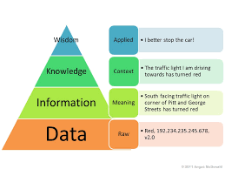
PR & Post-COVID-19 Communications
1. Information societies - treat information as a commodity; precision, honesty and openness; promote equality of access
2. Knowledge societies : Creation, dissemination, and utilization of information and knowledge-critical factor of production
We need increased knowledge about COVID-19
No one can hinder information and knowledge dissemination
Need for sustainable socially responsible messaging

Slide 21
Post-Crisis Communication
Deliver all information promised to stakeholders as soon as that information is known.
2. Keep stakeholders updated on the progression of recovery efforts including any corrective measures being taken and the progress of investigations.
3. Analyze the crisis management effort for lessons and integrate those lessons in to the organization’s crisis management system. 4. Sustainability of healthy practices 5. Planning for future pandemics 6. Establishing a future crisis management plan 7. Engage in continuous Crisis Communication training 8. Establish values or philosophies to communicate before crisis happens

Slide 22
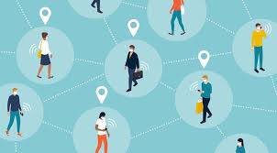
New Normal Communications- Key Recommendations
Use of media professionals
Use of positive psychological and sociological appeals
Accurate and timely information dissemination
Community engagement, OBV , community health mobilisation officers, National Orientation Agency
Credible the communication sources
Walking the talk.
Use of influencers, opinion leaders, infotainments, entertainment sector
Indigenous, traditional and new media
Campaign against stigmatization

Slide 23
Appreciation
Rotimi Williams Olatunji, PhD, arpa, MNIPR
Professor, Public Relations & Advertising, Dean, School of Communication,
Lagos State University, Ojo, Lagos, Nigeria
Voice: +234 8034716840; Email: rotimi.Olatunji@lasu.edu.ng

